Slide 1



Affichez ce slide afin que les personnes qui entrent dans la salle puissent valider qu’elles assistent à la bonne présentation.
Please show this slide before you start to talk so that attendees can validate that they are in the correct room
Live coding avec Yeoman & AngularJS
18h20 - 18h50 - Salle Louis Armstrong CD

Slide 2

Live coding avec
Yeoman & AngularJS
Matthieu Lux
Architecte chez Zenika
@Swiip

Slide 3


Matthieu Lux
Développeur & Architecte chez Zenika Lyon
  JavaScript : AngularJS, jQuery, Yeoman, Grunt...
  Java : Spring, MVC, Data, Integeration
  Mobilité : Android, PhoneGap
Membre actif du @LyonJS
Blog : http://swiip.github.com
Anciennement : ArchetypeJS

Slide 4
Modern workflows
for modern webapps
http://yeoman.io

Slide 5
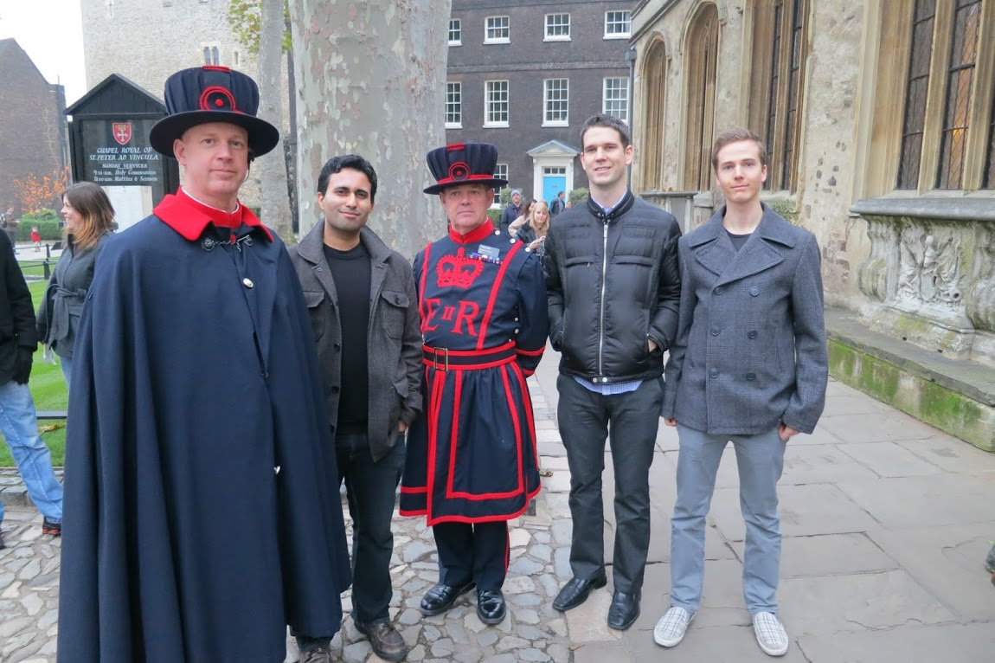
L'équipe
Paul Irish
Addy Osmani
Sindre Sohrus
Mickael Daniel
Eric Bidelman

Slide 6

YO yo --help
Usage: yo <generator> [arguments] [--help]
The webapp generator is bundled, while others can be installed with npm install <generator-name>
Officially supported generators:
webapp angular ember backbone chromeapp chrome-extension bootstrap mocha jasmine testacular
See a list of all available generators with npm search yeoman-generator
Now just run yo webapp and have a great day :)

Slide 7

Bower bower --help
Usage:
bower <command> <options>
Options:
--no-color - Do not print colors (available in all commands)
Commands:
help, install, list, ls, uninstall, update, link, lookup, info, register, search, cache-clean, completion
Example:
$ bower install bootstrap spine jquery
General Help:
http://git.io/bower

Slide 8

Grunt grunt --help
Usage
grunt [options] [task [task ...]]
Available tasks
server Alias for "clean:server", "coffee:dist",
"compass:server", "livereload-start",
"connect:livereload", "open", "watch" tasks.
test Alias for "clean:server", "coffee", "compass",
"connect:test", "mocha" tasks.
build Alias for "clean:dist", "test", "coffee",
"compass:dist", "useminPrepare", "imagemin",
"cssmin", "htmlmin", "concat", "uglify", "copy",
"usemin" tasks.
default Alias for "build" task.
For more information, see http://gruntjs.com/

Slide 9

HTML enhanced for web apps!
http://angularjs.org

Slide 10

JavaScript : Impératif
HTML
<p id="greeting"></p>
JavaScript
var isIE = document.attachEvent;
var addListener = isIE
? function(e, t, fn) { e.attachEvent('on' + t, fn); }
  : function(e, t, fn) { e.addEventListener(t, fn, false); };
addListener(window, 'load', function() (
var greeting = document.getElementById('greeting');
if (isIE) greeting.innerText = 'Hello World!';
else greeting.textContent = 'Hello World!';
};

Slide 11

jQuery : Impératif ++
HTML
<p id="greeting"></p>
<input type="text" id="greeting-input"/>
JavaScript
$(function() {
var greeting = $('#greeting'), input = $('#greeting-input');
greeting.html('Hello World!');
input.val('Hello World!');
input.keyup(function() {
greeting.html(input.val());
});
});

Slide 12
AngularJS : Déclaratif !
HTML
<div ng-controller="controller">
<p>{{greeting}}</p>
<input type="text" ng-model="greeting"/>
</div>
JavaScript
function controller($scope) {
$scope.greeting = 'Hello World!';
}

Slide 13
MVC
View (Dom)
<div ng-controller="controller">
<p>{{greeting}}</p>
<input type="text" ng-model="greeting"/>
</div>
Model (Scope)
{
greeting: 'Hello World!'
}
Controller
function controller($scope) {
$scope.greeting = 'Hello World!';
}

Slide 14
Composants
DOM Templating
Dependency Injection
Two Way Databinding
Directives
History Managment
Dirty Checking
Filtres
REST Resources
Scope Inheritance
Unit Testing
End to End Tests
Testacular

Slide 15

https://github.com/Swiip/yeoman-angular

